Slide 1
Natural Language Processing
Introduction

Slide 2
Introudction
Ever Imagined how you can communicate with each other.
What is the form of your communication
Can you define language?????
How can you make a computer to understand the language the language that you speak.
Processing Natural Language is AI Complete Problem
Often termed as Computational Linguistics (ore its origin from linguistics)

Slide 3
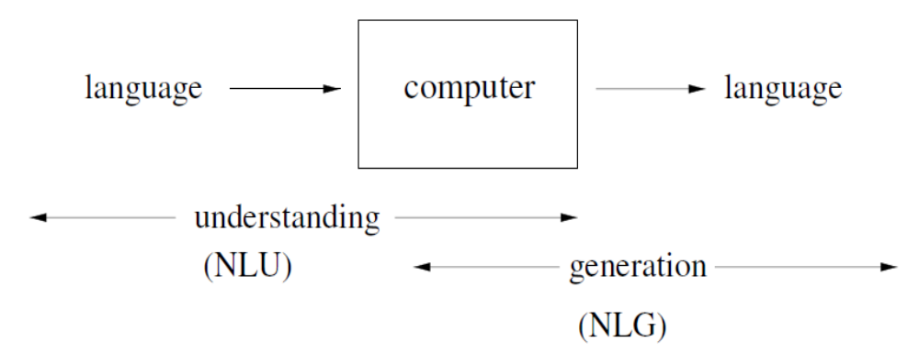
What is NLP
Computers using natural languages (language spoken by humans) as input and/or output.

Slide 4
Alternate Views
Computational models of human language processing.
  Programs that operate internally the way humans do
Computational models of human communication
  Programs that interact like humans
Computational systems that efficiently process text and speech

Slide 5
Natural Language Processing
Information Retrieval
Language Analysis
Machine Translation

Slide 6
A few applications of NLP
Spelling correction, grammar checking …
Better search engines
Information extraction
Psychotherapy; etc.
New interfaces:
  Speech recognition (and text-to-speech)
  Dialogue systems (USS Enterprise onboard computer)
  Machine translation (Google Translate)

Slide 7
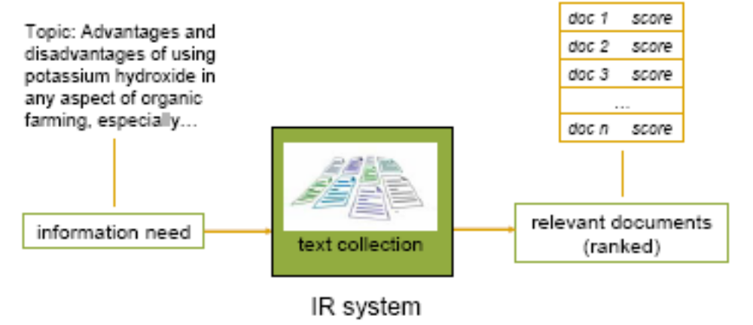
Applications of NLP
Information Retrieval

Slide 8
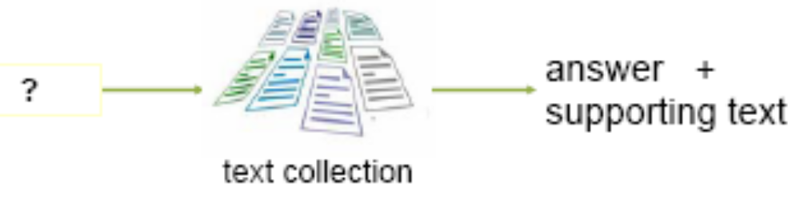
Applications of NLP
Question Answering System
    How many calories are there in pizza
    Who is Prime Minister of India
    Who was the first Indian in Space

Slide 9
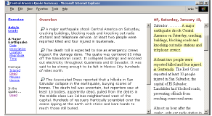
Applications of NLP
Text Summarization

Slide 10
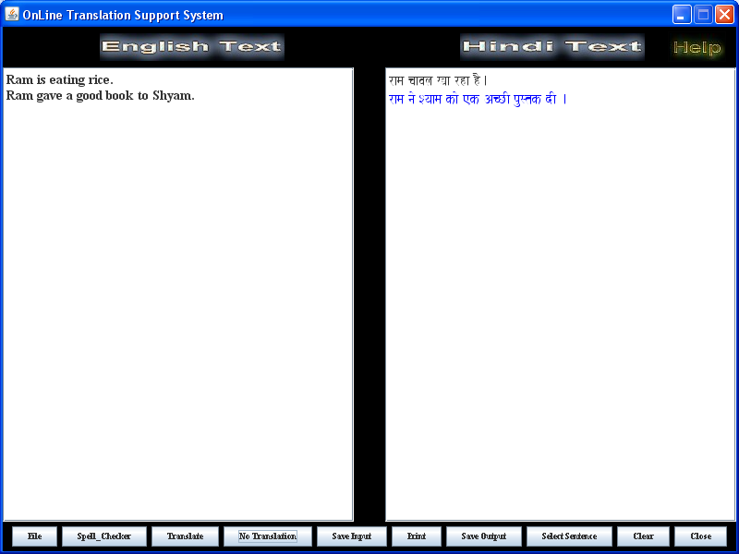
Applications of NLP
Machine Translation

Slide 11
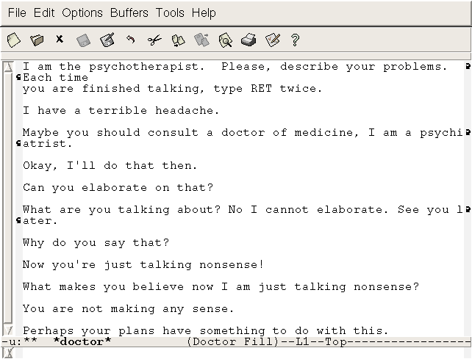
Applications of NLP
Psychotherapist

Slide 12
Phonology
This level deals with the interpretation of speech sounds within and across words.
There are, in fact, three types of rules used in phonological analysis:
  phonetic rules – for sounds within words;
  phonemic rules – for variations of pronunciation when words spoken together
  prosodic rules – for fluctuation in stress and intonation across a sentence.
In an NLP system that accepts spoken input, the sound waves are analyzed and encoded into a digitized signal for interpretation by various rules or by comparison to the particular language model being utilized.

Slide 13
Morphology
This level deals with the componential nature of words, which are composed of morphemes – the smallest units of meaning.
For example, the word preregistration can be morphologically analyzed into three separate morphemes: the prefix pre, the root registra, and the suffix tion.
Since the meaning of each morpheme remains the same across words, humans can break down an unknown word into its constituent morphemes in order to understand its meaning.
Similarly, an NLP system can recognize the meaning conveyed by each morpheme in order to gain and represent meaning.
For example, adding the suffix –ed to a verb, conveys that the action of the verb took place in the past.
This is a key piece of meaning, and in fact, is frequently only evidenced in a text by the use of the -ed morpheme.

Slide 14
Lexical (POS Tagging)
At this level, humans, as well as NLP systems, interpret the meaning of individual words.
Several types of processing contribute to word-level understanding – the first of these being assignment of a single part-of-speech tag to each word.
In this processing, words that can function as more than one part-of-speech are assigned the most probable part-of-speech tag based on the context in which they occur.

Slide 15
Syntactic
This level focuses on analyzing the words in a sentence so as to uncover the grammatical structure of the sentence.
This requires both a grammar and a parser.
The output of this level of processing is a (possibly delinearized) representation of the sentence that reveals the structural dependency relationships between the words.
There are various grammars that can be utilized, and which will, in turn, impact the choice of a parser.
Syntax conveys meaning in most languages because order and dependency contribute to meaning.
For example the two sentences: ‘The dog chased the cat.’ and ‘The cat chased the dog.’ differ only in terms of syntax, yet convey quite different meanings.

Slide 16
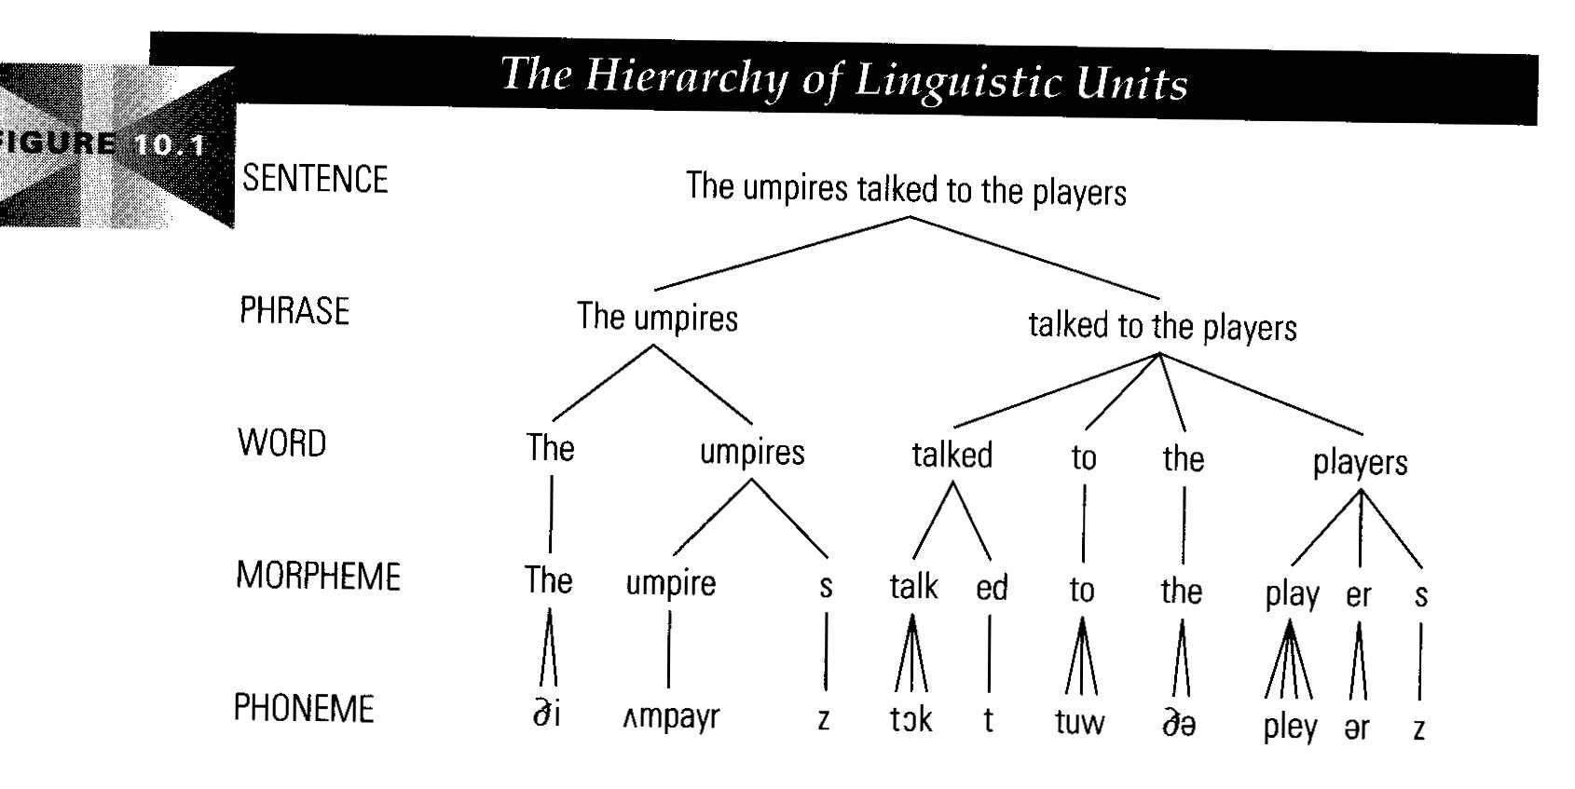
Level of Language Processing

Slide 17
Semantic
This is the level at which most people think meaning is determined, however, as we can see in the above defining of the levels, it is all the levels that contribute to meaning.
Semantic processing determines the possible meanings of a sentence by focusing on the interactions among word-level meanings in the sentence.
This level of processing can include the semantic disambiguation of words with multiple senses.
For example, amongst other meanings, ‘file’ as a noun can mean either a folder for storing papers, or a tool to shape one’s fingernails, or a line of individuals in a queue.
If information from the rest of the sentence were required for the disambiguation, the semantic, not the lexical level, would do the disambiguation.

Slide 18
Discourse
While syntax and semantics work with sentence-length units, the discourse level of NLP works with units of text longer than a sentence.
That is, it does not interpret multi-sentence texts as just concatenated sentences, each of which can be interpreted singly.
Rather, discourse focuses on the properties of the text as a whole that convey meaning by making connections between component sentences.

Slide 19
Pragmatics
This level is concerned with the purposeful use of language in situations and utilizes context over and above the contents of the text for understanding.
The goal is to explain how extra meaning is read into texts without actually being encoded in them.
This requires much world knowledge, including the understanding of intentions, plans, and goals.
For Example – The city administrators refused the demonstrators a permit because they feared violence.

Slide 20
Example
रोशनी चली गई
लोग परेशान थे
पसीने से पानी पानी हो रहे थे
अब आ गई,
सबकी साँस में साँस आई
बहुत डांट पड़ी
Looking at just one sentence we cannot understand the complete passage.
We have to look at the complete passage and correlate each sentence.
If the sentences do not relate with other, you will not be able to get any meaning.

